Slide 1
Gun violence
File created on: 5/12/24 8:35:36 PM EDT

Slide 2
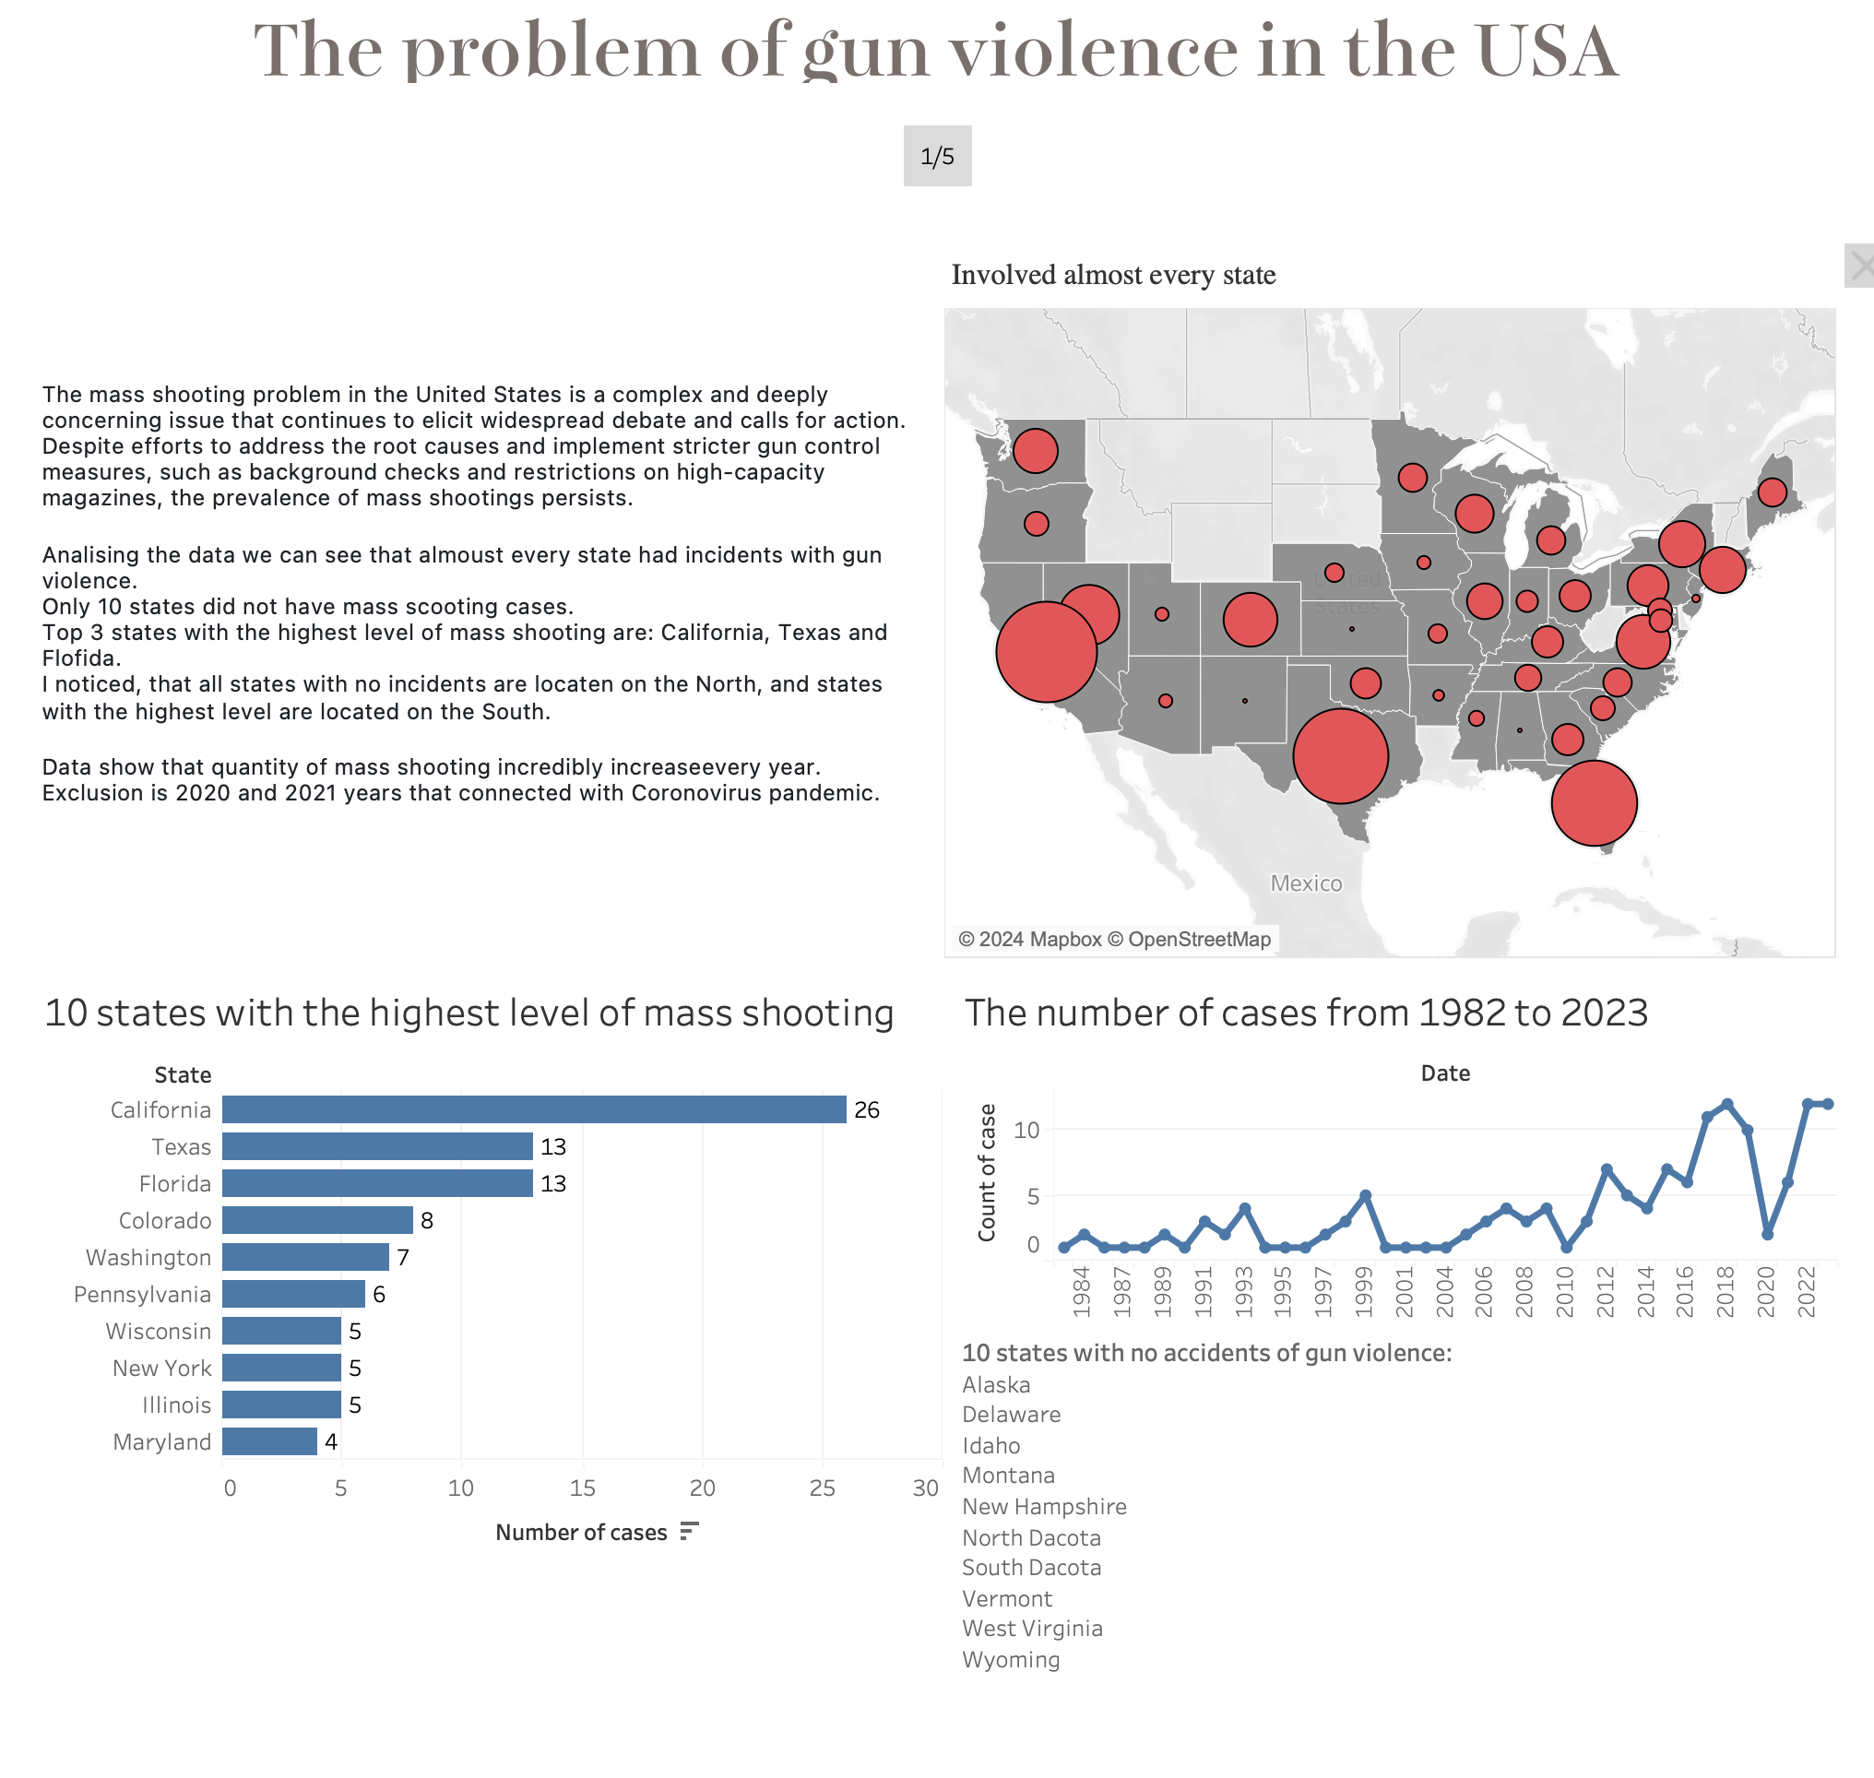

Slide 3
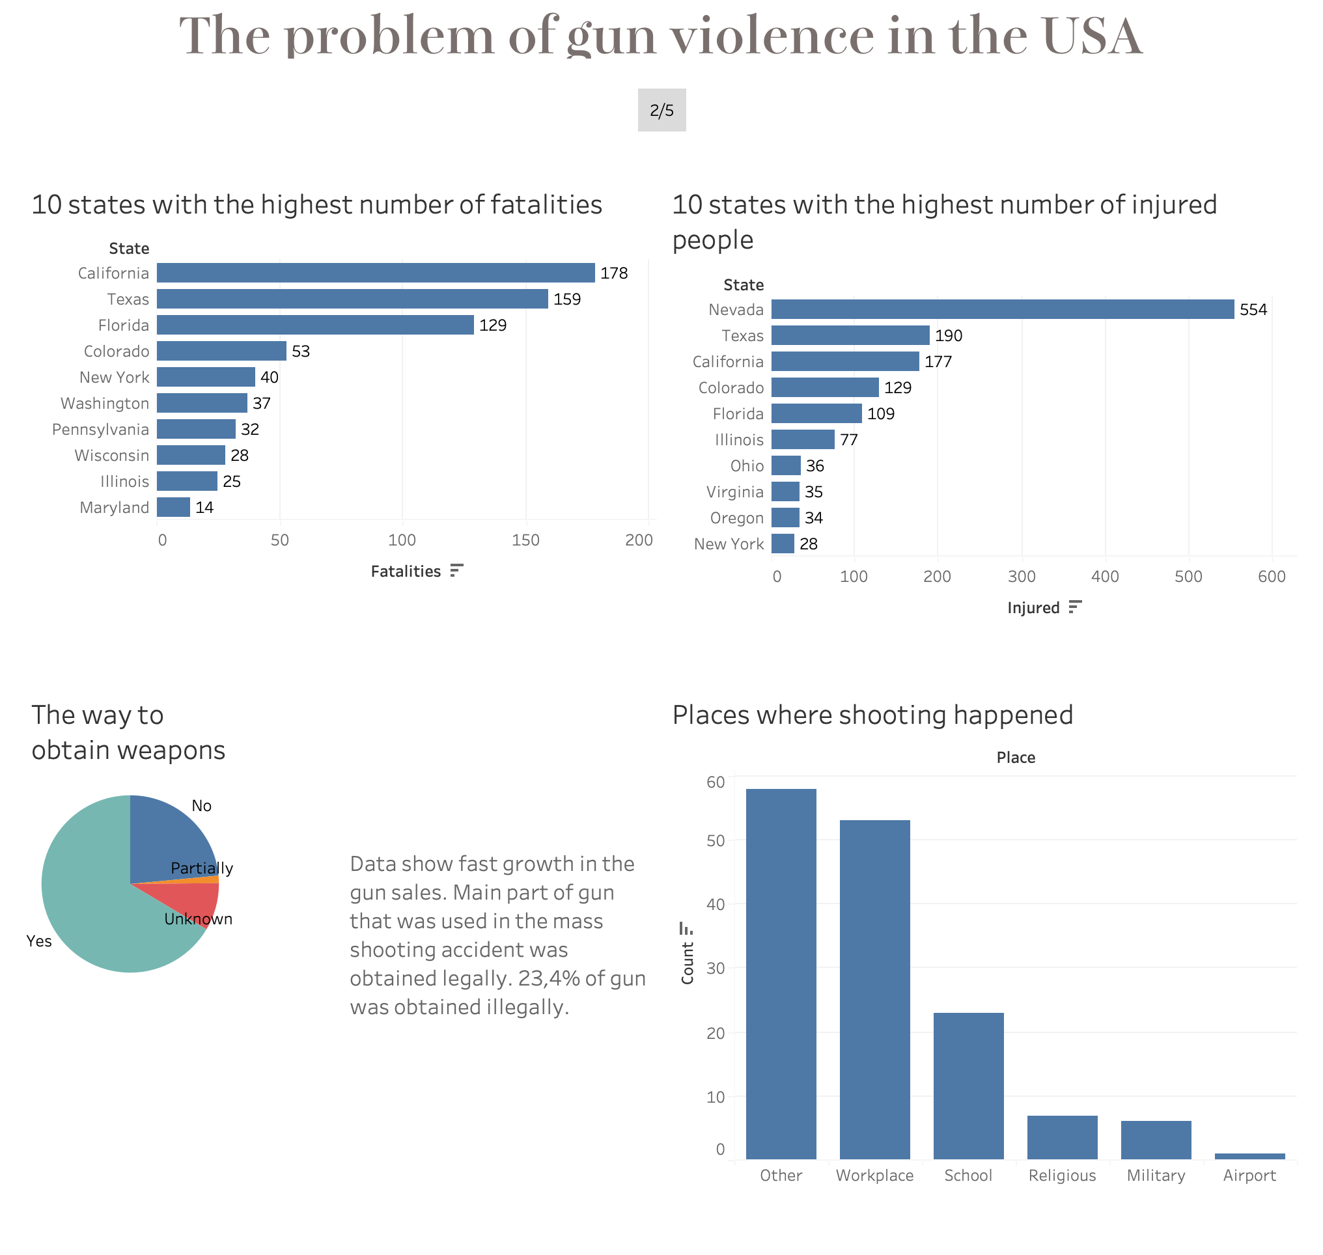

Slide 4
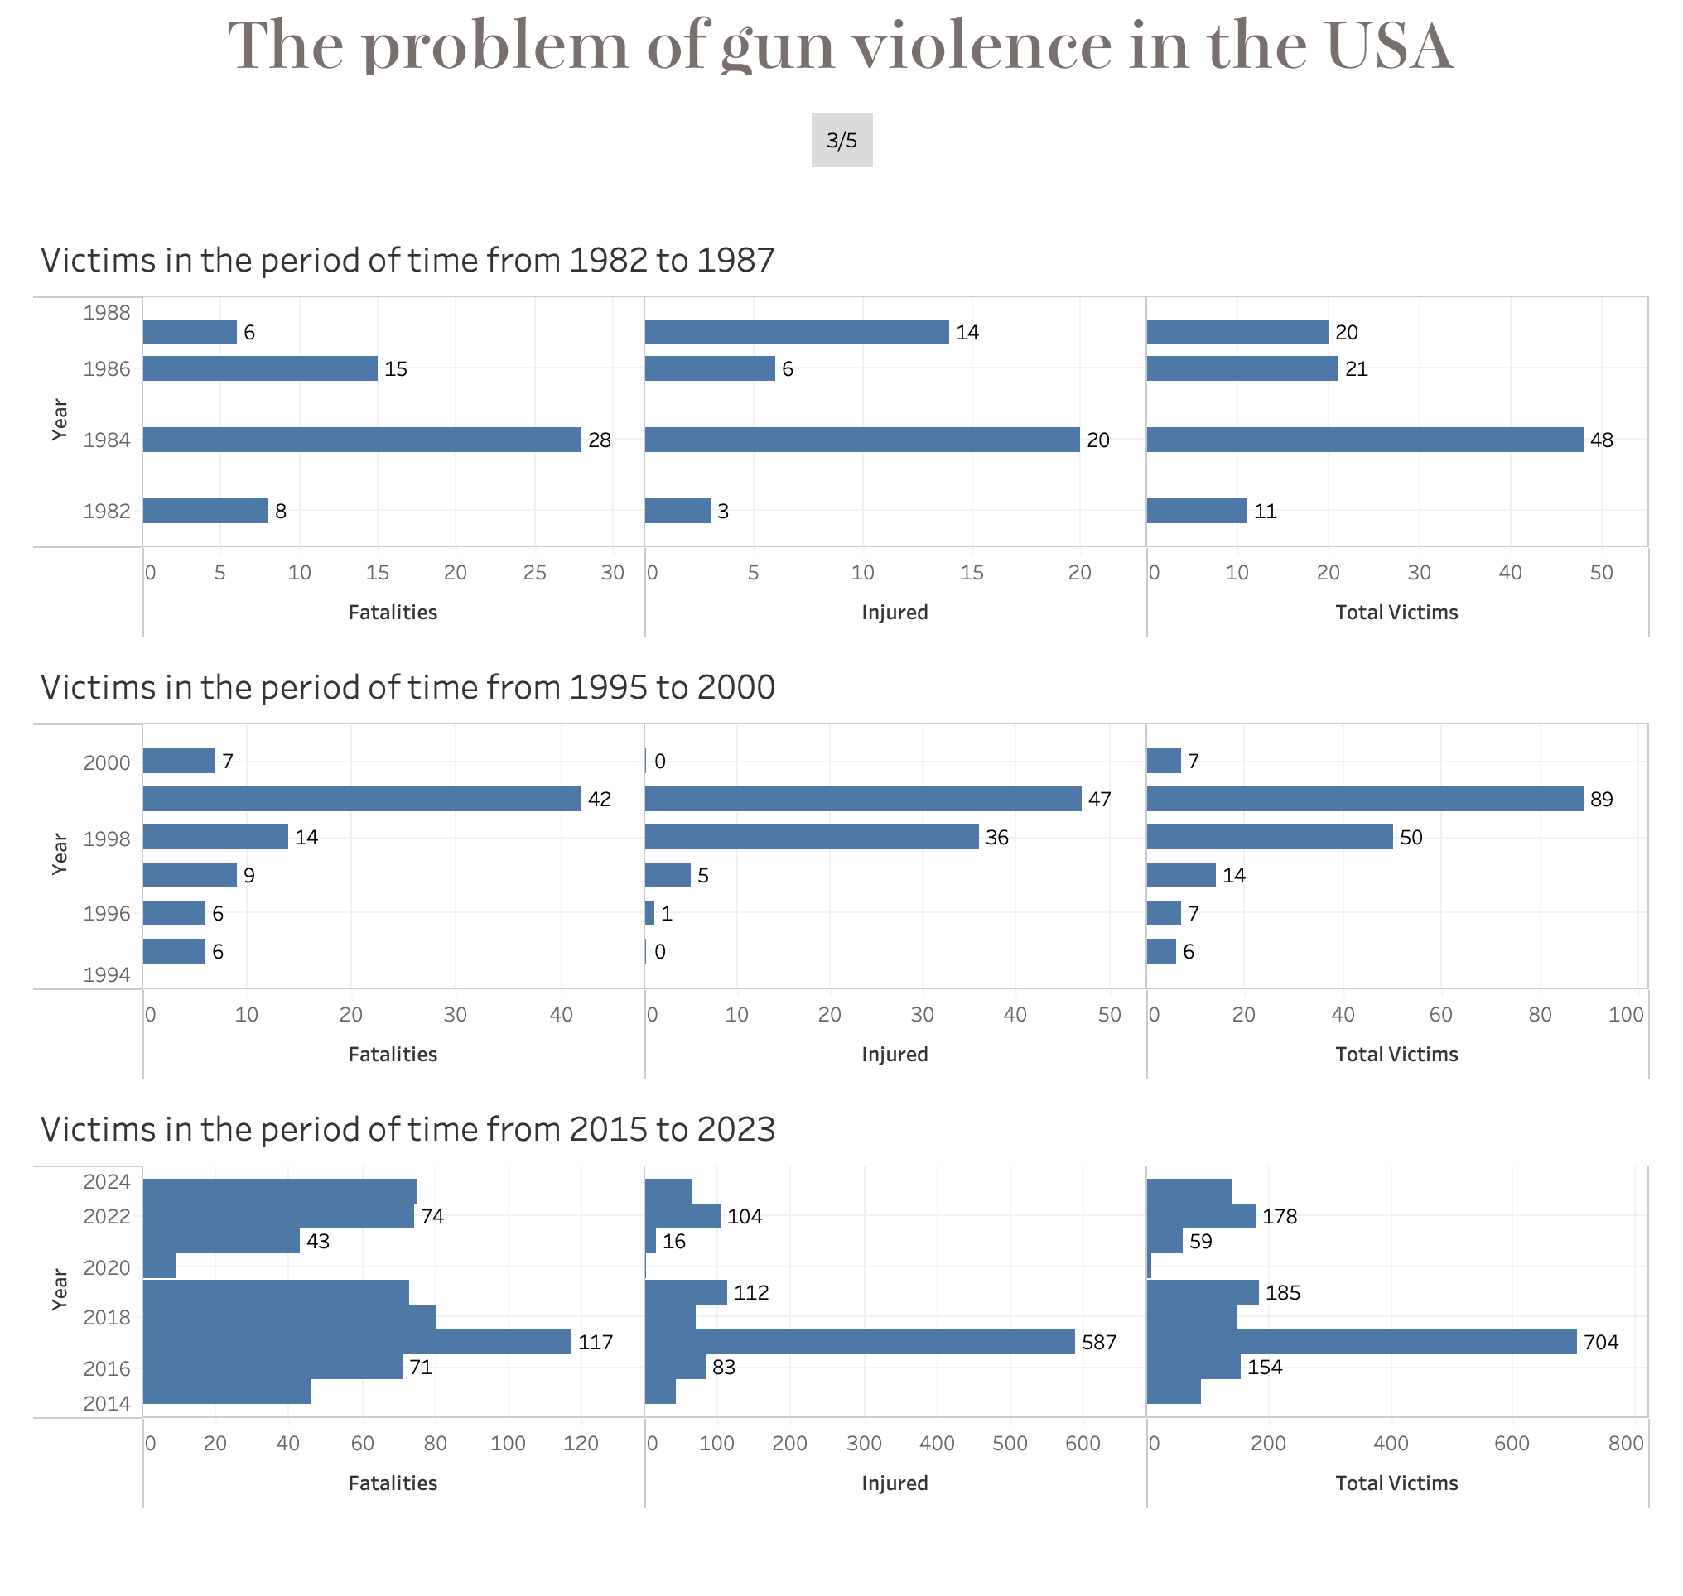

Slide 5
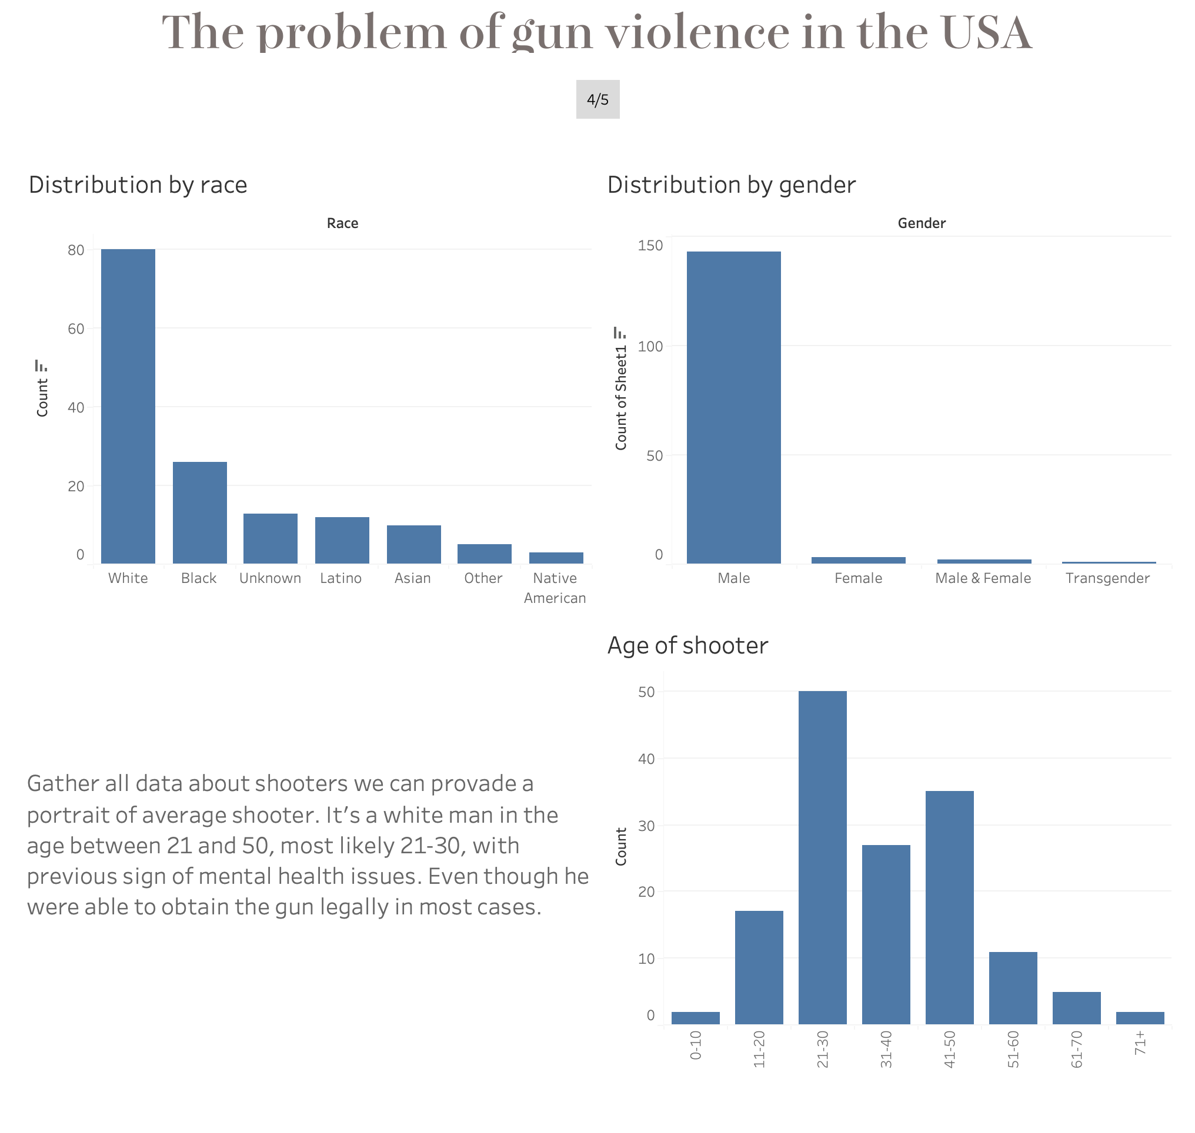

Slide 6
